Slide 1
Group Discussion (20 Minutes)
Download the PDF file containing the anatomy of a database application
Review the sample mechanics (steps involved) in implementing the different functions expected in a Database Application
What are the patterns of steps within the mechanics for Core Data Management Functions
Creating a Record
Updating a Record
Deleting a Record
Search and Listing using Filters
Viewing of a Record
What are the key differences between Report Generation using Filters and Search/Listing using Filters?
How are the ideas of Reduced Data Entry Error, Ease of Use being implemented in the mechanics for all the functions of a database application
How is the idea that functions within database applications should be performing being implemented in the mechanics? (a) Data Collection (b) Data Validation (c) Data Processing (d) Storing of Results (e) Data Presentation
How is the principle of CONSISTENCY and DURABILITY implemented in the mechanics?

Slide 2

Anatomy of a Basic DB Application

Slide 3
CCINFOM
Fundamentals of Database System
Notes:
CCINFOM is a course intended to provide fundamental knowledge and skills in the Design and Development of Database Systems, particularly Relational Database Systems.
Relational Database Systems are Database Systems that uses Relational Database – a Database founded on the concept of Relations to store and organize data.
To design and develop Database Systems, it is important to understand what are its components, the different technologies that can be used to implement each component as well as the skills in order to design and develop each component. The past 9 weeks of CCINFOM has been about each component of the Database System.

Slide 4
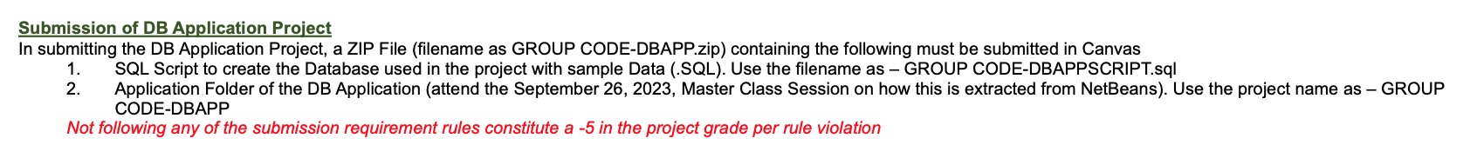
Notes for 1-2023-2024
Submission of DB Application as indicated in the Syllabus is still
Week 11, Nov. 18, 2023 (S) 1800, Online Submission in Canvas. Late submission will not be accepted by Canvas.
Any missing component of the submission constitute 0.0 in the DB Application Project. No consideration will be provided by giving a chance to resubmit or submit the correct version (regardless if you have not edited or not) once the project has been submitted.
Even the video on how to Zip your Project for Submission has been uploaded in OneDrive since September 3, 2023
The details on how the ideas presented in today’s lesson is implemented in Java and JavaServerPages (JSP) are in the masterclass 3.0 video uploaded since October 18, 2023.

Slide 5
Notes for 1-2023-2024
Only the technologies within the Virtual Machine can be used in the DB Application. Any form of violation of this constitute 0.0 grade for the DB Application Project.
Any modification to the approved proposal also constitute the function affected to be deemed NOT IMPLEMENTED.
The use of the Virtual Machine ensures that the submitted project will run on my Virtual Machine. If your project will not run, then it will constitute 0.0 grade for the DB Application Project. There are no reasons to be entertained why your project will not run in MY Virtual Machine.
What defines Complete and Correct implementation will be strictly enforced this trimester, no considerations for effort and no plus points will be provided to any group. If the function has noted missing features, that is/are not providing either
reduction of input errors
ease of use of performing the function
adequate navigation to get in or out of the function
adequate display of information needed for the function whether before, during or after, then the function
use of existing data within the database to facilitate the function
appropriate characteristics of quality information is preserved
then it is deemed INCOMPLETE and INCORRECT implementation. Making unrealistic assumptions for the project affecting the DB and the application, will not excuse or redeem you from your function to be marked INCOMPLETE and INCORRECT.

Slide 6
Components of a Database System
1
2
3
Database Server
Database
Database Application
Database Management System (DBMS)
Module
1.0
Support the Data Life Cycle (Collect, Store, Process, Distribute, Present)
Ensures that the Characteristics of Quality Information is preserved
The advantages of Database Systems over File-Based Systems
The role of the Database Management System (DBMS)
The Database System comprises the Data and Software components of the Database Environment
The Database System works with other components of the Database Environment (People, Process, Hardware)
Notes:
A Database System is composed of three components – the Database, the Database Management System and the Database Application. The Database and the Database Management System combined comprises what is called the Database Server.

Slide 7
Components of a Database System
Database Server
Database
Module 2.0
Management Tool (MySQL Workbench) to interactively communicate with the DBMS using
SQL
Database Management System (DBMS)
DML
DDL
DCL
Receives SQL Statements to perform data operations and in retrieval cases returns requested data

Slide 8
Components of a Database System
Database Server
Database
Module 2.0
Management Tool (MySQL Workbench) to interactively communicate with the DBMS using
SQL
Database Management System (DBMS)
DML
DDL
DCL
SQL-DML SELECT, INSERT, UPDATE, DELETE
SQL-SELECT Statements
Retrieving Data from a Single Table – LEVEL 1
Retrieving Data from Multiple Tables (Inner Join) – LEVEL 2
Retrieving Data from Multiple Tables (Outer Join) – LEVEL 3
Retrieving Data with Aggregates (including Conditions on Groups) – LEVEL 4
Retrieving Data using SubQuery Technique – LEVEL 5
Module
2.0

Slide 9
Components of a Database System
Database Server
Database
Database Application
Database Management System (DBMS)
Module 3.0 The (Relational) Database is designed by using different techniques
DDL
CREATE TABLE statements to implement the design to an actual database

Slide 10
Components of a Database System
Database Server
Database
Module 4.0
Developed Application using Java Technologies embedded with SQL, to support Core Data Management, Transaction and Report Generation Functions
Database Management System (DBMS)

Slide 11
Components of a Database System
Tier 3
Tier 2
Tier 1
Database Server
Database
Database Application
Database Management System (DBMS)
Data Processing Programs
(Back-End)
Input and Output Programs
(Front-End)

Slide 12
What makes up a Basic Database Application?
Report Functions
MENU
Allow the user to navigate the application and select what it will be performing
Core Data Management Functions
Transaction Functions

Slide 13
What makes up a Basic Database Application?
Reports are different from Listings as they contain aggregates. These aggregates are performed by retrieving data from both Core and Transaction Data. Reports are generated by selecting filters that determines what core and transaction data that the application will use to generate the report
Report Functions
Database Server
Tables that provide reference data needed for transactions to be performed
Core Data Tables
Transaction Data Tables
Tables where data resulting from performing transactions are recorded. Results of transactions may update some core data
Performs a sequence of steps to complete a transaction.(This is also applicable to Data Core Management Functions) These steps will include (a) Getting Data from the user (b) Validating the Data (c) Processing the Data (d) Storing the Results (e) Presenting the result to the user
Performs the functions of viewing, creating, updating and deleting of records in each Core Data Tables. Additional Functions include (a) Searching using Filter (b) Listing using Filter
Core Data Management Functions
Transaction Functions

Slide 14
Reality of Application Functions
The steps involve to perform the function may need multiple pages with forms
At any step, the user should have the option to get out of the transaction (cancel the transaction) and go back to main menu
The CONSISTENCY and DURABILITY principles of any function (Core Data or Transaction) states that nothing is SAVED in the database unless all the data collection and processing is completed, and it is SAVED, it is saved permanently
There are two other principles but these are not covered in CCINFOM. These are Atomicity and Isolation

Slide 15
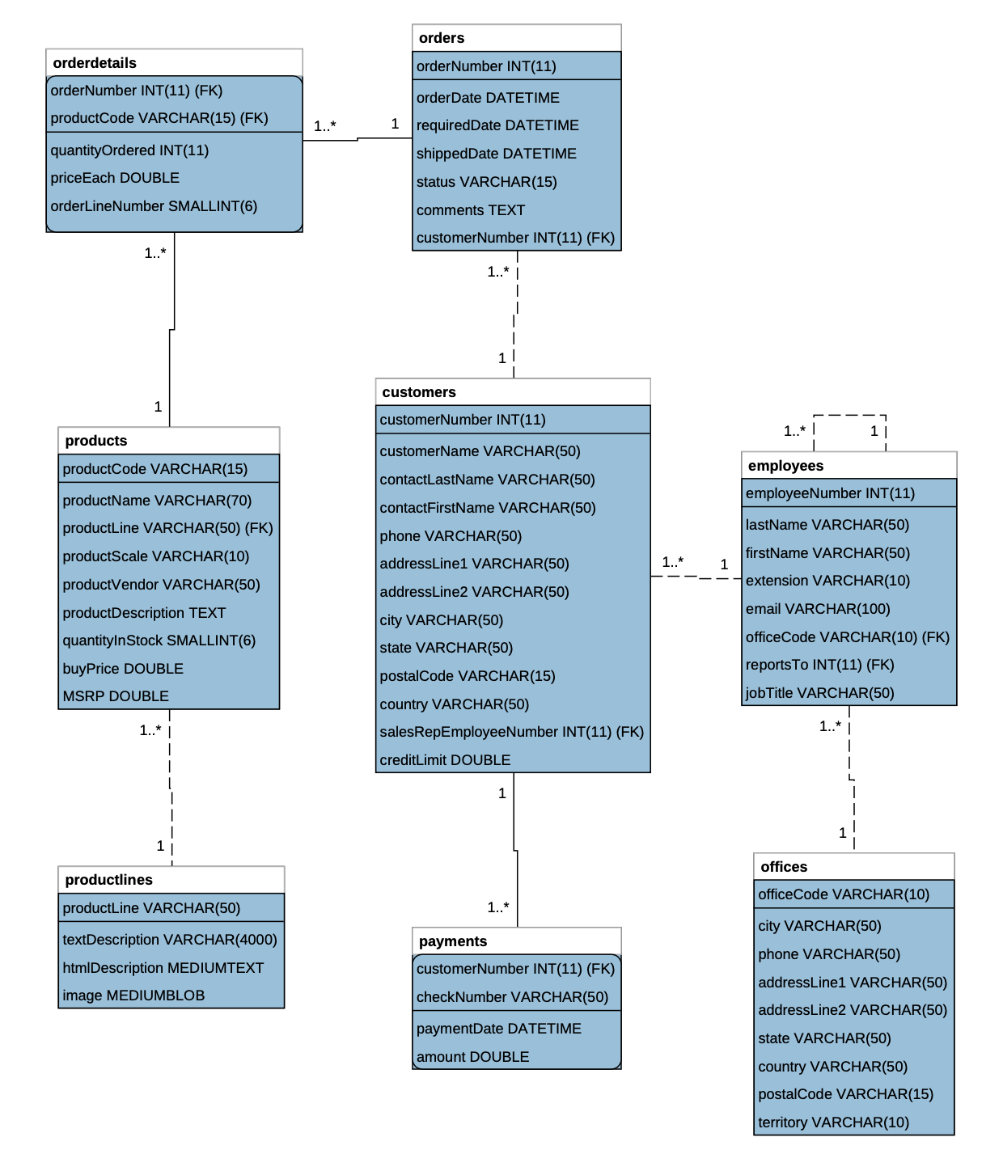
Transaction Data Table
Transaction Data Table
Core Data Table
Core Data Table
Core Data Table
Core Data Table
Core Data Table
Transaction Data Table

Slide 16
Core Data Functions
Create Record of a Products (a)
Update Record of a Product (b)
View Record of a Product (c)
Delete Record of a Product (d)
List Products based on Filter (e)
Search Products based on Filter (f)

Slide 17
Core Data Functions
(a) Create Record of a Customer
(b) Update Record of a Customer
(b) View Record of a Customer
(c) Delete Record of a Customer
(e) List Customers based on Filter
(f) Search Customers based on Filter

Slide 18
Core Data Function on Create of Product
Display in the form, elements where user can enter data about Products (Product Code, Product Name, Product Scale, Product Vendor, Product Description, Quantity In Stock, Buy Price and MSRP.
Retrieve from the database the list of product lines and put then in choices (dropdown), that the user can choose from for the product line of the product being recorded.
In the same form if user clicks on Cancel, go back to main menu
In the same form if user clicks on Proceed, then go to next page.
Check if all the fields are provided with values. If one of them does not have a value, display on screen that the values for the fields are required and provide a button to go back to (a). Otherwise, proceed to (f)
Check if all the fields are of correct data type, if one of them does not conform to the correct data type, display on screen that the value must be in correct data type and provide a button to go back to (a). Otherwise, proceed to (g)
Save the new record to the database
Display on screen the newly saved record
Provide a button to go back to the main menu and a button to go back to (a) to create another product record

Slide 19
Core Data Function on Update of Customer
Display in the form, elements where user can enter his/her Sales Person ID and Customer Number
In the same form if user clicks on Cancel, go back to main menu
In the same form if user clicks on Proceed, then go to next page.
Check if Sales Person ID and Customer Number was provided with values. If one of them does not have a value, display on screen that both values are required and provide a button to go back to (a). Otherwise, proceed to (e)
Check if all the fields are of correct data type, if one of them does not conform to the correct data type, display on screen that the value must be in correct data type and provide a button to go back to (a). Otherwise, proceed to (f)
Retrieve Customer Record
Check if customer belongs to the Sales Person. If not belonging to the Sales Person, display on screen that the customer is not under the user’s list of customer and provide a button to go back to (a), Otherwise, proceed to (h)
Display in the form, elements where the old values from the record can be shown and updated, and buttons to cancel and save the update. Clicking on the cancel button will go back to main menu.
User will update the old values as he decides
User clicks on Save to go to the next page
Check if all the fields were provided with values. If one of them does not have a value, display on screen that the values are required and provide a button to go back to (d). Otherwise, proceed to (l)
Check if all the fields are of correct data type, if one of them does not conform to the correct data type, display on screen that the value must be in correct data type and provide a button to go back to (d). Otherwise, proceed to (m)
Save the updated data to the database
Display the old and new values of the record
Provide a button to go back to the main menu and a button to go back to (a) to update another customer record

Slide 20
Core Data Function on Search of Employees
Display form, elements representing fields used as criteria to search employees. For this search, the filter criteria are last name, first name, office code and job title.
For job title, the list of job titles are retrieved from the database and placed on choices (dropdown). For the office code, the list of office codes are retrieved from the database and placed on choices (dropdown).
The user puts or selects values for his/her criteria choices. Not all filter criteria may be given a value or selected a value on, this means that the criteria is not used.
In the same form if user clicks on Cancel, go back to main menu
In the same form if user clicks on Search, then go to next page.
Using the filter criteria used in the previous page, retrieve the list of employees (employee number, last name and first name, email and job title) sorted accordingly and display them on screen as a list with proper headers
In the same form, if user clicks on Main menu, go back to main menu
In the same form, if user clicks on Search Again, go back to (a)
Core Data Function on View of Employees
Display in the form, a field where user can enter the employee number to view the record
In the same form if user clicks on Cancel, go back to main menu
In the same form if user clicks on View, then go to next page.
The record of the employee is retrieved from the database
If the record is not found, display on screen that the employee cannot be found, and provide a button to go back to (a). Otherwise, proceed to (f)
Display the retrieved record of the employee
Provide a button to go back to the main menu and a button to go back to (a)

Slide 21
Core Data Function on Delete of Employees
Display in the form, a field where user can enter the employee number to delete the record
In the same form if user clicks on Cancel, go back to main menu
In the same form if user clicks on View, then go to next page.
The record of the employee is retrieved from the database
If the record is not found, display on screen that the employee cannot be found and provide a button to go back to (a). Otherwise proceed to (f)
Display the retrieved record of the employee
Check the database if the employee is being used in Customers.
If being used, display on screen that the employee cannot be deleted and provide a button to go back to (a). Otherwise, proceed to (i).
Provide a button to go back to the main menu and a button to go the next page to delete the record.
Delete the record from the database
Display “Record is Deleted”
Provide a button to go back to the main menu and a button to go back to (a) to delete another customer record

Slide 22
Transaction on Sales
Display in the form, field to enter the Sales Person ID, Customer Number and Required Date
In the same form if user clicks on Cancel, go back to main menu
In the same form if user clicks on Order, then go to next page.
Check if Sales Person ID, Customer Number and Required Date was provided with values. If one of them does not have a value, display on screen that both values are required and provide a button to go back to (a). Otherwise, proceed to (e)
Check if all the fields are of correct data type, if one of them does not conform to the correct data type, display on screen that the value must be in correct data type and provide a button to go back to (a). Otherwise, proceed to (f)
Retrieve Customer Record
Check if customer belongs to the Sales Person. If not belonging to the Sales Person, display on screen that the customer is not under the user’s list of customer and provide a button to go back to (a). Otherwise, proceed to (h).
Retrieve all ordered amount and payments made. Compute if there are still amounts needed to be paid.
Check if Customer is eligible to order based on if credit limit has not been exceeded. If customer is not eligible, display on screen that customer is not eligible to order and provide a button to go back to (a). Otherwise, proceed to (i).
Save the order record in memory
In the same form if user clicks on Cancel, go back to main menu
In the same form if user clicks on Order Products, then go to next page.
Display in the form, fields to enter what product is being ordered, quantity to order and price to use for the product
Retrieve available products that can be ordered and put in the choices (dropdown)
User puts in data for the ordered products
In the same form if user clicks on Cancel, go back to main menu
In the same form if user clicks on Add to Cart, then go to next page.

Slide 23
Transaction on Sales
Retrieve data about the Product
Check if quantity ordered is within the quantity of the product, if not then display on screen that there are not enough products and provide a button to go back to (m). Otherwise, proceed to (t).
Check if price is below buyPrice, if it is then display on screen that the price cannot be below the buy Price amount and provide a button to go back to (m). Otherwise, proceed to (u).
Save the order details in memory
In the same form if user clicks on Add another Order, go back to (m)
In the same form if user clicks on Save Order, then go to next page.
Generate a new Order Number by checking the last order number and adding 1
Save the order record in the database with Order Date is the date today, Shipped Date is NULL, Status is In Process, Comments is NULL
Save every product ordered in OrderDetails. Order Line Number starts with 1 and increments for every product ordered.
Update Products by deducting the quantity ordered from the quantity in stock
Display the details of the order and order details
Provide a button to go back to the main menu and a button to go back to (a) to perform another Sales Transaction

Slide 24
Transaction on Payment
Display form, field to enter the customer Number
In the same form if user clicks on Cancel, go back to main menu
In the same form if user clicks on Retrieve, then go to next page.
Retrieve customer record
Retrieve total amount of orders
Retrieve total amount of payments made
Compute for amount still needed to pay
Display amount to be paid on screen
Display in the form, fields for the user to enter the amount to be paid and the check number
In the same form if user clicks on Cancel, go back to main menu
In the same form if user clicks on Pay, then go to next page.
If amount of payment exceeds the amount needed to be paid, display on screen that amount to be paid is less than payment amount, and provide a button to go back to (a). Otherwise, proceed to (m)
Check if check number already exists. If check number already exists, display on screen that check number is already used and and provide a button to go back to (a). Otherwise, proceed to (n)
Save the payment record
Display the result the payment details
Provide a button to go back to the main menu and a button to go back to (a) to make another payment transaction

Slide 25
Report Generation - Sales Report
Display form, elements representing fields used as criteria to generate the report. For this report, the filter criteria are start month and end month, start year and end year, and customer number
The user puts or selects values for his/her criteria choices.
In the same form if user clicks on Cancel, go back to main menu
In the same form if user clicks on Generate, then go to next page.
Using the filter criteria used in the previous page, retrieve the report using SQL, sorted accordingly and display them on screen as a list with proper headers - MONTH, YEAR, CUSTOMERNUMBER, TOTAL SALES
In the same form, if user clicks on Main menu, go back to main menu
In the same form, if user clicks on Generate Report Again, go back to (a)

Slide 26
Important to take note of for the DB Applications Project
A Database Design is needed
A Database implemented is needed
The database must have adequate sample values to demonstrate the feature. For example:
Report Generation cannot be adequately demonstrated if there are not enough data already inside the DB.
Search cannot be adequately demonstrated if there are not enough data already inside the DB.
Update and Delete cannot be adequately demonstrated if there are not enough data to perform the functions
If the functions cannot be adequately demonstrated because there is lack of data in the database, the function is deemed NOT IMPLEMENTED. How did you adequately test the application, if in the first place, there are not enough data in your database.
Take note that in the requirements for submission, the DATABASE with adequate data is needed.

